Slide 1
Factory Method
Design Pattern

Slide 2
Outline
Intro to PizzaStore with simple static factory
Live demo introducing factory method pattern
Look at the definition of factory method pattern
Pros and cons
Differences vs Abstract Factory pattern

Slide 3
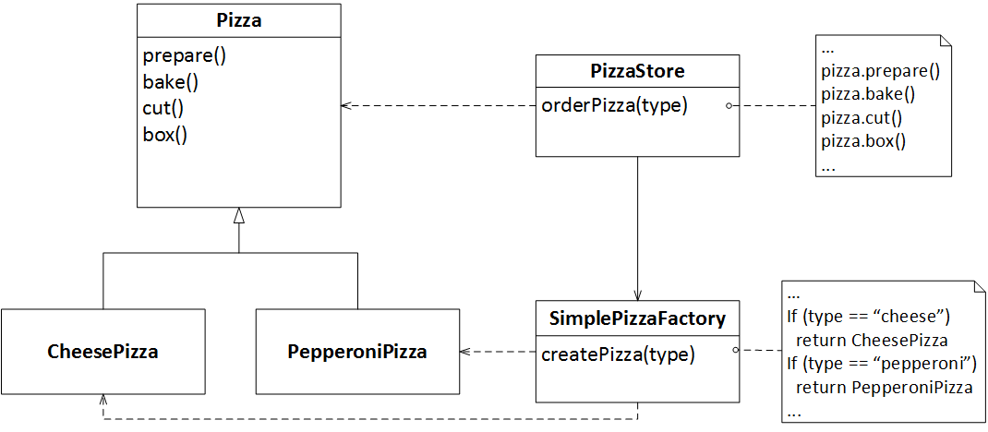
PizzaStore
Notes:
SimplePizzaFactory could have many clients, e.g PizzaStoreMenu
createPizza could be a static method

Slide 4
Demo

Slide 5
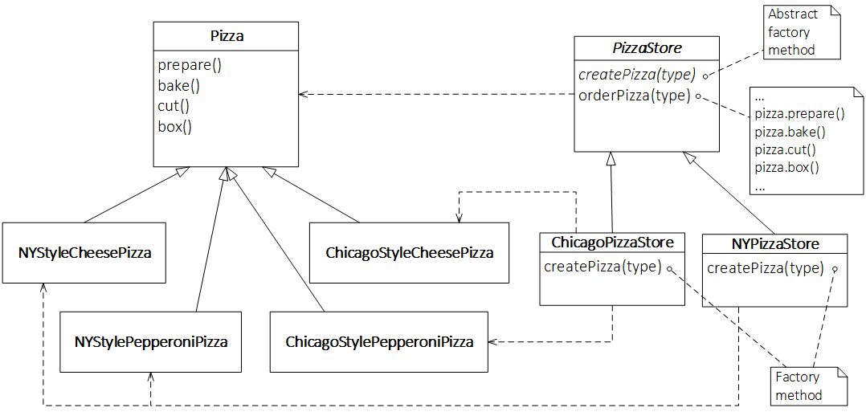
Factory Method Pattern - Example

Slide 6
Factory Method Pattern - Defined

Slide 7
Applicability

Slide 8
Pros and Cons
TODO

Slide 9
Differences vs Abstract Factory Pattern
TODO Class vs Object
TODO Pattern is only one method rather than whole

